Slide 1
Market Comparison: Bitcoin, Ethereum, and Dogecoin Group 2: Catina Wright, Maggie Rosen, Sravya Kottisa, Kevin Arawattigi
Notes:
Catina

Slide 2
Project analysis slide 3
Agenda
Project Overview & Goal
Brief Background
About BTC, ETH & DOGE
Trends
Market Influences
Correlations
Predictions
Conclusion
Next Steps
Q & A
BTC (Bitcoin)
Limited supply of 21 million
The first and most well-known cryptocurrency, launched in 2009
Widely accepted and widely used
Notes:
Catina

Slide 3
Project analysis slide 3
Proposal
Goal
To identify the correlations between BTC, ETH & DOGE coin using 1 year old data
Data Source
Coinbase
Roles
Sravya: GIT Repository Maintenance, Data gathering(API) & Clean up, MAPE
Forecast the coin prices for 72 hrs using Prophet model and compare with actual market price
Calculate the MAPE (Mean Absolute Percentage Error) for Prophet model
Token Metrics/success
Yahoo Finance
Maggie: Data Analysis, Prophet predictions
Catina: Data Analysis, Presentation
Kevin: Ideation
BTC (Bitcoin)
Limited supply of 21 million
Widely accepted and widely used
Notes:
Catina

Slide 4
Project analysis slide 3
History
BTC (Bitcoin)
Cryptocurrency, currency in digital form that is not overseen by a central authority.¹
Operate in a decentralized manner
Not subject to traditional fiscal year
Three most popular: Bitcoin, Dogecoin, and Ethereum.
Limited supply of 21 million
The first and most well-known cryptocurrency, launched in 2009
Widely accepted and widely used
Notes:
Catina:
Instead, cryptocurrencies function on blockchain networks, where transactions are recorded and validated continuously. The fiscal year concept typically applies to entities that have financial reporting requirements, such as businesses or governments, to track their income, expenses, and financial health over a specified period. Cryptocurrencies, being decentralized digital assets, do not have such reporting requirements, so they do not have a fiscal year in the traditional sense.^{1 (Britannica Money)}
(Britannica, T. Editors of Encyclopaedia (2024, March 14). cryptocurrency. Encyclopedia Britannica. https://www.britannica.com/money/cryptocurrency)
Not subject to traditional fiscal year structures like those seen in corporations or government entities.

Slide 5

Project analysis slide 3
Bitcoin
BTC
Considered a store of value and a medium of exchange
Has the largest market capitalization (~$500B)
Limited supply of 21 million
The first and most well-known cryptocurrency, launched in 2009
Widely accepted and widely used
Notes:
Catina
The first cryptocurrency was Bitcoin, created by an anonymous computer programmer or group of programmers known as Satoshi Nakamoto in 2009. Satoshi Nakamoto was concerned that traditional currencies were too reliant on the trustworthiness of banks or governments to work properly.
Bitcoin relies on public key cryptography, in which users have a public key that is available for everyone to see and a private key known only to their computers. In a Bitcoin transaction users receiving Bitcoins send their public keys to users transferring the Bitcoins. Users transferring the coins sign with their private keys, and the transaction is then transmitted over the Bitcoin network. So that no Bitcoin can be spent more than once at the same time, the time and amount of each transaction is recorded in a ledger file that exists at each node of the network. The identities of the users remain relatively anonymous, but everyone can see that certain Bitcoins were transferred. (Britannica, T. Editors of Encyclopaedia (2024, March 14). cryptocurrency. Encyclopedia Britannica. https://www.britannica.com/money/cryptocurrency

Slide 6
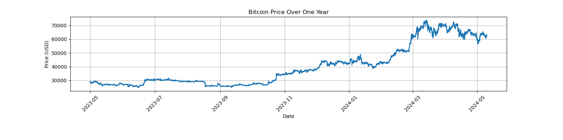
Project analysis slide 5
Bitcoin Price Over One Year
Notes:
Catina,
The chart depicts the Bitcoin price over the span of a year, commencing from May 2023 and concluding in May 2024. Notably, the price initiated around 30K and maintained relative stability for the following two months. However, momentum started surging past 40K between November and January 2024, with an upward trend hitting above 70K until May 2024.

Slide 7
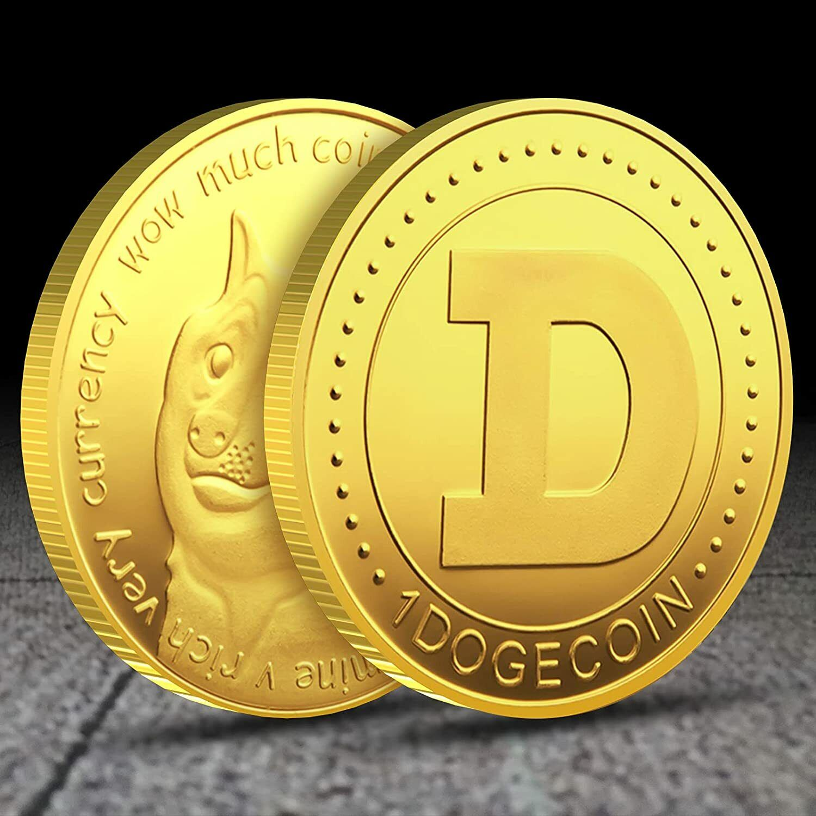
Project analysis slide 3
Dogecoin
DOGE
Fast block time (~1 minute) and low transaction fees
Infinite supply, with ~130 billion DOGE in circulation
Launched in 2013 as a joke, but gained a large following
Community-driven, with a strong focus on charity and fundraising
Notes:
Maggie’s notes here

Slide 8
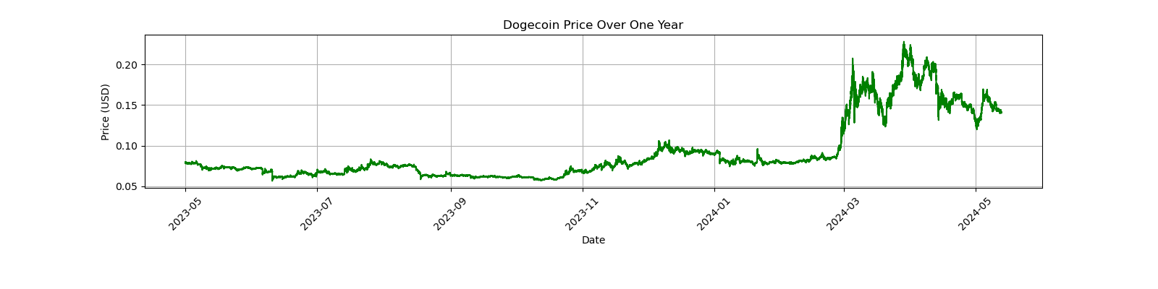
Project analysis slide 5
Dogecoin Price Over One Year
Notes:
Maggie

Slide 9

Project analysis slide 3
Ethereum
ETH
Programmable blockchain, enabling smart contracts and decentralized applications (dApps)
Has a larger supply than BTC, with ~120 million ETH in circulation
Launched in 2015, second-largest market capitalization (~$200B)
Fastest block time among the three (~15 seconds)
Notes:
Maggie

Slide 10
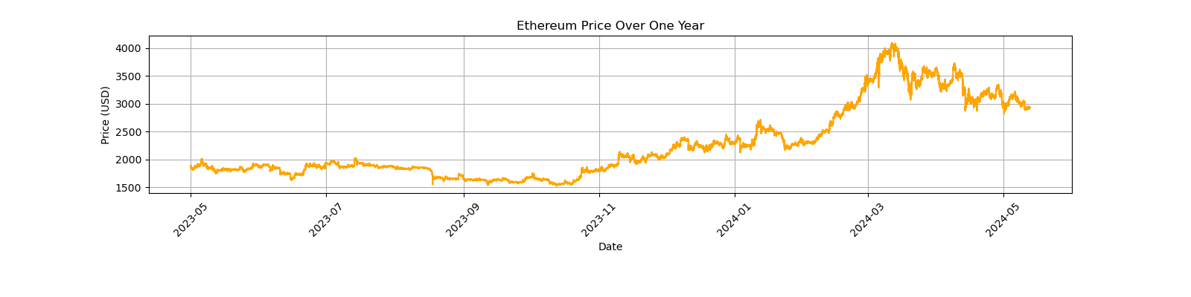
Project analysis slide 5
Ethereum Price Over One Year
Notes:
Maggie

Slide 11
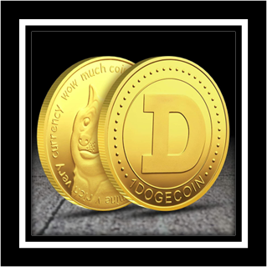

Project analysis slide 6
Comparative Analysis
Bitcoin
Dogecoin
Ethereum
BTC and ETH have a much larger market capitalization than DOGE.
ETH has a much faster block time than BTC, while DOGE has the fastest block time among the three.
All three are decentralized, but BTC is more focused on being a store of value, while ETH is focused on smart contracts and dApps. DOGE is more community-driven and focused on charity.
Notes:
Maggie

Slide 12
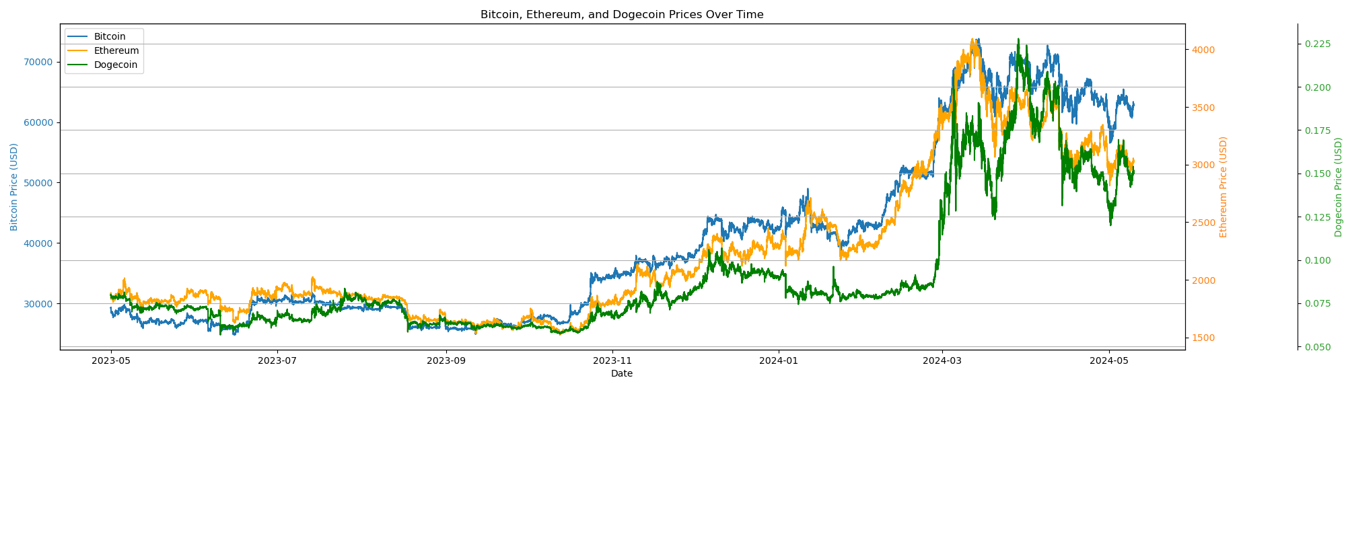
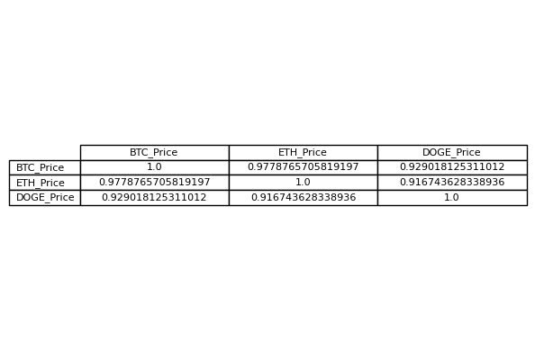
Project analysis slide 5
Correlations
Conclusions:
The three cryptocurrencies displays a consistent movement pattern, often moving in tandem with each other.
DODG and ETH exhibited a particularly strong correlation, frequently moving in sync.
This connection can be attributed to the fact that DODG's value is primarily derived from ETH, resulting in their prices moving together.
Notes:
Maggie

Slide 13
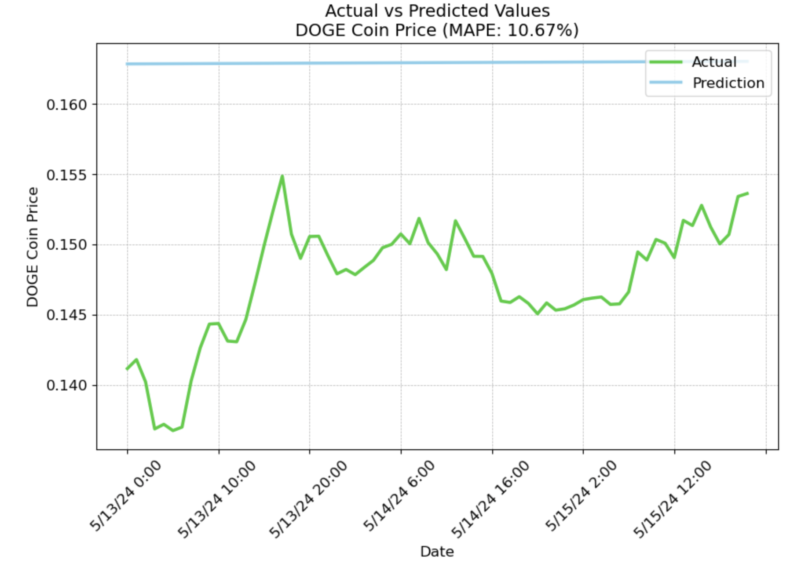
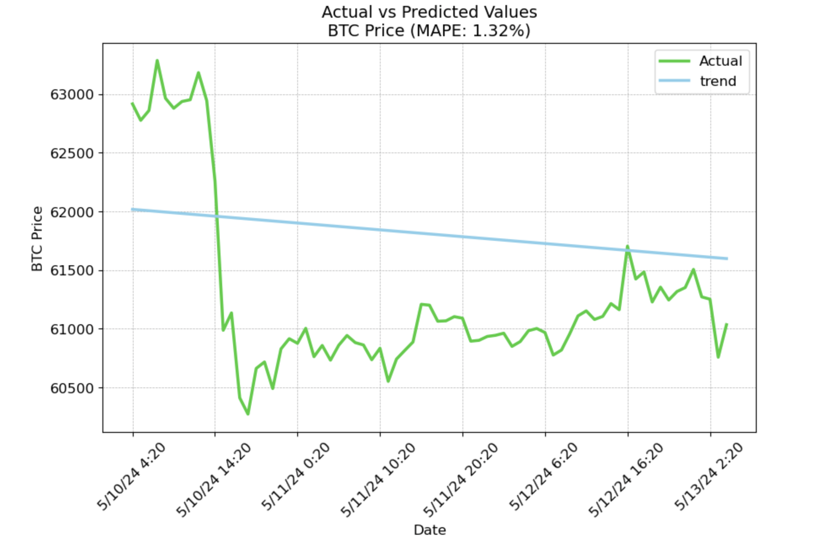
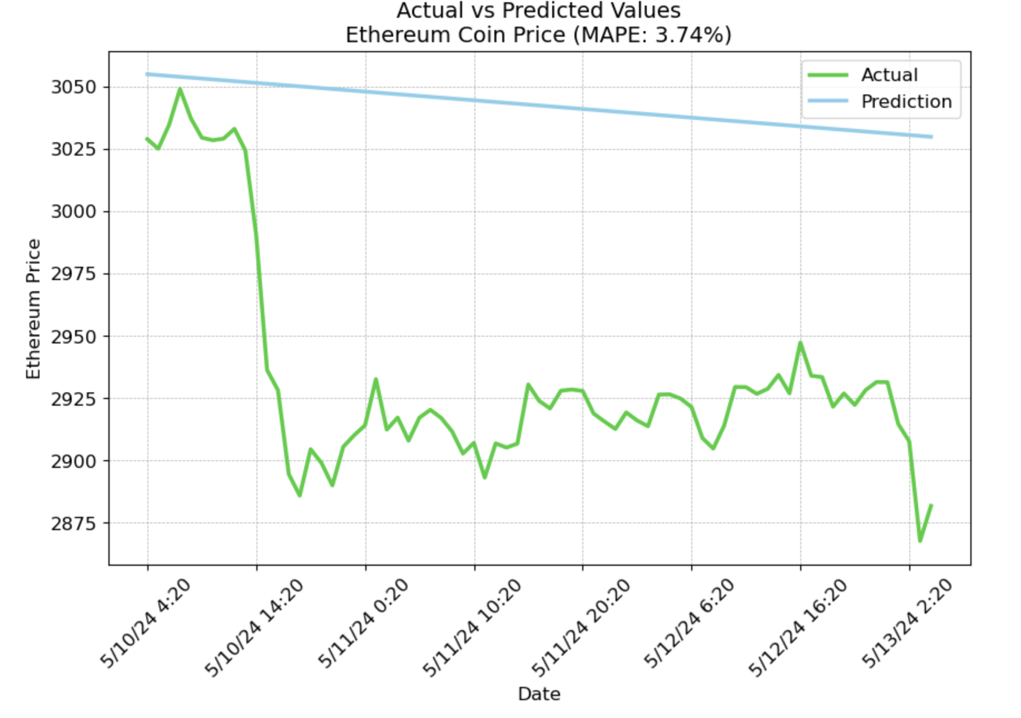
Project analysis slide 5
72 Hrs. Predictions Using Prophet Model
Notes:
Maggie

Slide 14
Project analysis slide 5
72 Hrs. Predictions Using Prophet Model
Notes:
Maggie

Slide 15
Project analysis slide 5
72 Hrs.Predictions Using Prophet Model
Notes:
Maggie

Slide 16
Project analysis slide 5
72 Hrs. Predictions Using Prophet Model
Notes:
Maggie

Slide 17
Project analysis slide 5
72 Hrs. Predictions Using Prophet Model
Conclusion:
The accuracy of the Prophet model in forecasting the 3 cryptocurrency prices varies
On an average it achieved a precision of 94.5%
The quality is dependent on various factors like, quality of data, complexity of the model and volatility of cryptocurrency market and other influences
Next Steps:
To use Prophet in conjunction with other tools and techniques to get a more comprehensive view of the market
Integrate Prophet with machine learning algorithms, like regression or classification models, to improve forecasting accuracy.
Use deep learning models to capture complex patterns in the data.
Leverage pre-trained models that are available and fine-tune for specific cryptocurrency forecasting task.
Notes:
Maggie

Slide 18
Project analysis slide 5
Q & A

Slide 19
Thank You

Slide 20
Outline (delete once complete)
Slide 1: Introduction
Brief overview of cryptocurrencies and their significance in the financial market.
Slide 2: Overview of Bitcoin (BTC)
Brief introduction to Bitcoin.
Price comparison chart: March 1, 2024 - May 6, 2024. (or year if you use a year)
Highlight key price movements and events during the period.
Slide 3: Overview of Ethereum (ETH)
Brief introduction to Ethereum.
Price comparison chart: March 1, 2024 - May 6, 2024.
Highlight key price movements and events during the period.
Slide 4: Overview of Dogecoin (DOGE)
Brief introduction to Dogecoin.
Price comparison chart: March 1, 2024 - May 6, 2024.
Highlight key price movements and events during the period.
Slide 5: Comparative Analysis
Comparative chart showing the price movements of Bitcoin, Ethereum, and Dogecoin side by side.
Discuss any correlations or divergences in their price movements.
Mention any significant events impacting all or specific cryptocurrencies during the period.

Slide 21
Slide 6: Market Performance Metrics
Graphical representation of various performance metrics (e.g., market cap, trading volume) for Bitcoin, Ethereum, and Dogecoin.
Analysis of these metrics and their implications for investors.
Slide 7: Factors Influencing Price Movements
Discussion on the factors that influenced the price movements of Bitcoin, Ethereum, and Dogecoin during the specified period.
Factors may include macroeconomic trends, regulatory news, technological developments, etc.
Slide 8: Conclusion
Summary of key findings from the comparative analysis.
Insights into the future outlook of Bitcoin, Ethereum, and Dogecoin based on the observed trends and factors influencing their prices.
Slide 9: References
List of references/sources used for data and analysis.
This structure should give you a solid foundation for creating your PowerPoint presentation on the stock market comparison between Bitcoin, Ethereum, and Dogecoin.

Slide 22
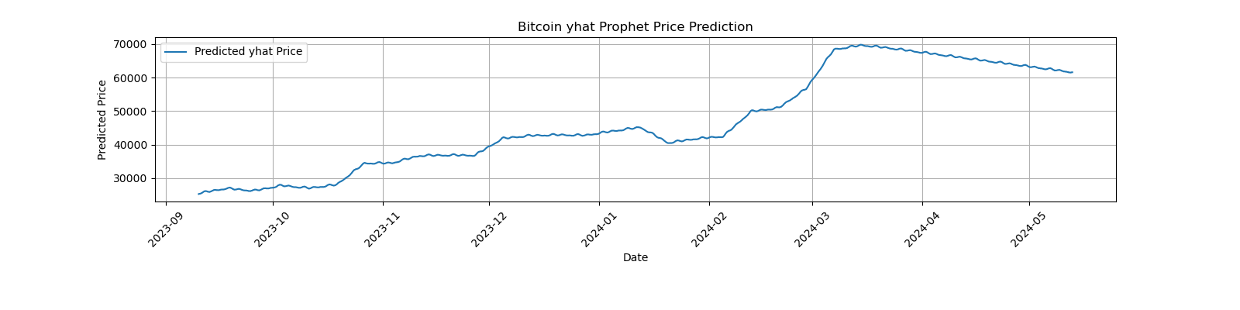
Project analysis slide 5
Prophet Price Predictions: Bitcoin

Slide 23
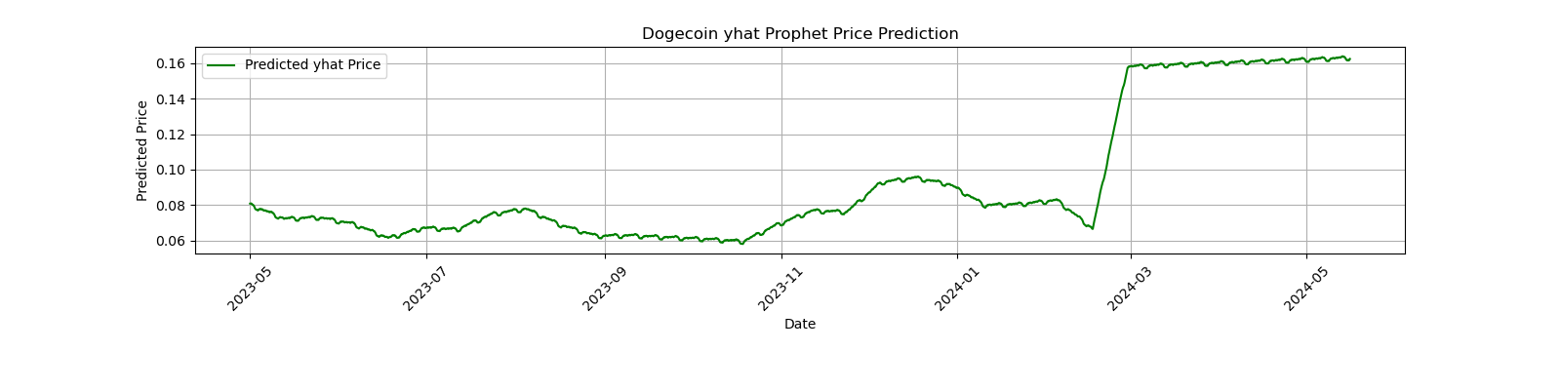
Project analysis slide 5
Prophet Predictions: Dogecoin

Slide 24
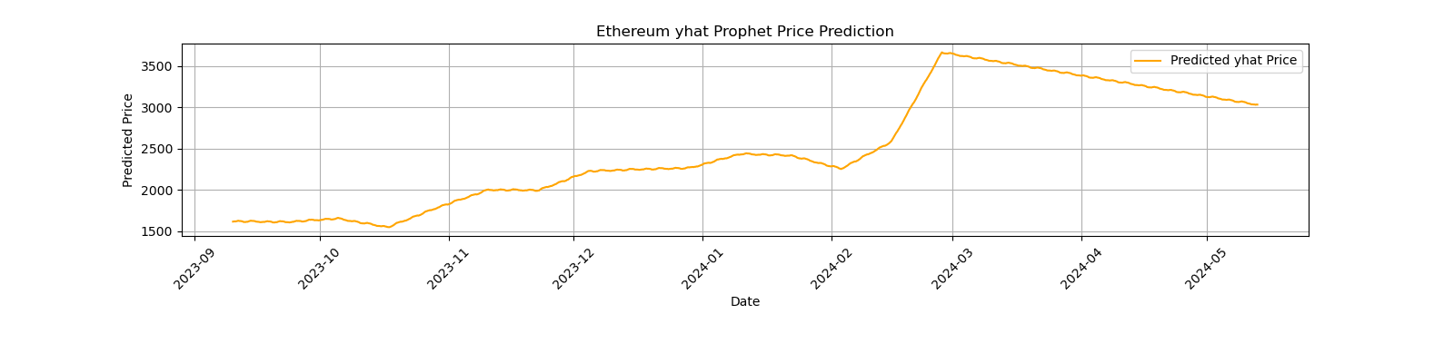
Project analysis slide 5
Prophet Price Predictions: Ethereum

